Slide 1
Distruptalicious Legal Instruction: A year of learning outcomes and multiple assessments
By Eric Porterfield, Jenny Wondracek, and Beth Donahue

Slide 2
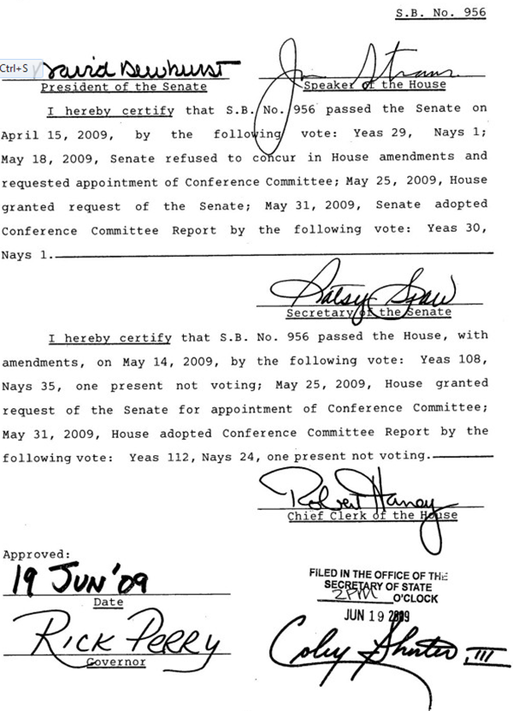
UNT Dallas College of Law:
An Idea Brought Into Reality in 2009

Slide 3
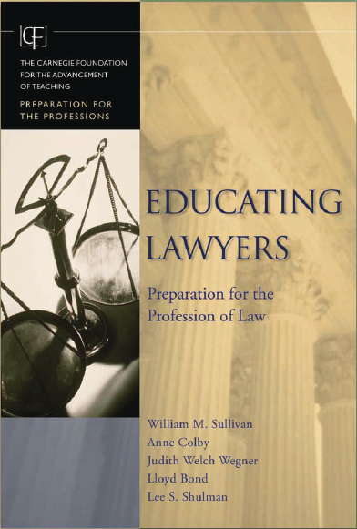
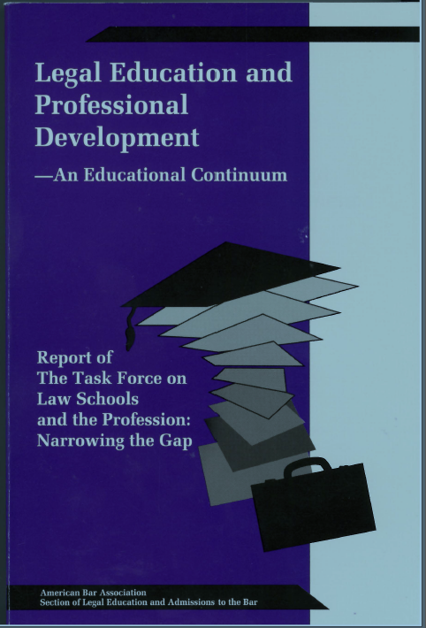
Some of the Drivers of Institutional Change
Judge Royal Furgeson, ret’d,
Founding Dean
Associate Dean for Academic Affairs
Ellen Pryor
The Carnegie Report
The MacCrate Report

Slide 4
The Revised ABA Standards – Adopted August 2014

Slide 5
Standard 302. LEARNING OUTCOMES
A law school shall establish learning outcomes that shall, at a minimum, include competency in the following:
(a) Knowledge and understanding of substantive and procedural law;
(b) Legal analysis and reasoning, legal research, problem-solving, and written and oral communication in the legal context;
(c) Exercise of proper professional and ethical responsibilities to clients and the legal system; and
(d) Other professional skills needed for competent and ethical participation as a member of the legal profession.

Slide 6
Standard 314. ASSESSMENT OF STUDENT LEARNING
A law school shall utilize both formative and summative assessment methods in its curriculum to measure and improve student learning and provide meaningful feedback to students.

Slide 7
Interpretation 314-1 Formative assessment methods are measurements at different points during a particular course or at different points over the span of a student’s education that provide meaningful feedback to improve student learning. Summative assessment methods are measurements at the culmination of a particular course or at the culmination of any part of a student’s legal education that measure the degree of student learning.

Slide 8
Interpretation 314-2 A law school need not apply multiple assessment methods in any particular course. Assessment methods are likely to be different from school to school. Law schools are not required by Standard 314 to use any particular assessment method.

Slide 9
Standard 315. EVALUATION OF PROGRAM OF LEGAL EDUCATION, LEARNING OUTCOMES, AND ASSESSMENT METHODS
The dean and the faculty of a law school shall conduct ongoing evaluation of the law school's program of legal education, learning outcomes, and assessment methods; and shall use the results of this evaluation to determine the degree of student attainment of competency in the learning outcomes and to make appropriate changes to improve the curriculum.

Slide 10
Interpretation 315-1 Examples of methods that may be used to measure the degree to which students have attained competency in the school’s student learning outcomes include review of the records the law school maintains to measure individual student achievement pursuant to Standard 314; evaluation of student learning portfolios; student evaluation of the sufficiency of their education; student performance in capstone courses or other courses that appropriately assess a variety of skills and knowledge; bar exam passage rates; placement rates; surveys of attorneys, judges, and alumni; and assessment of student performance by judges, attorneys, or law professors from other schools. The methods used to measure the degree of student achievement of learning outcomes are likely to differ from school to school and law schools are not required by this standard to use any particular methods.

Slide 12
Learning Outcomes

Slide 18
Rubrics

Slide 21
Reports

Slide 23
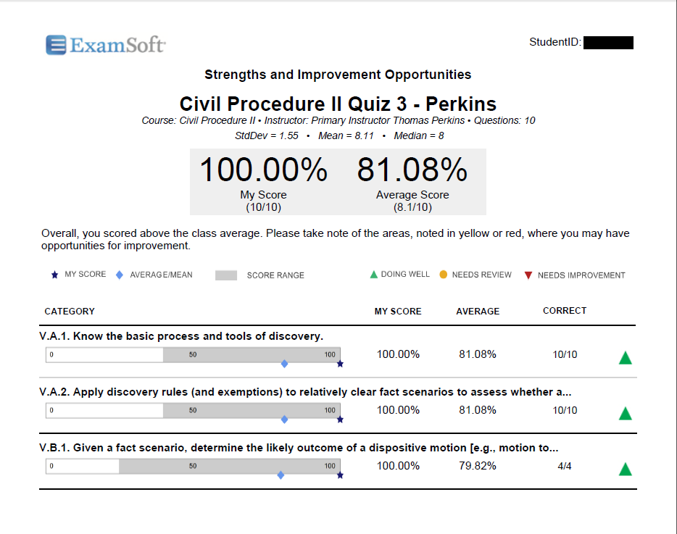

Slide 24
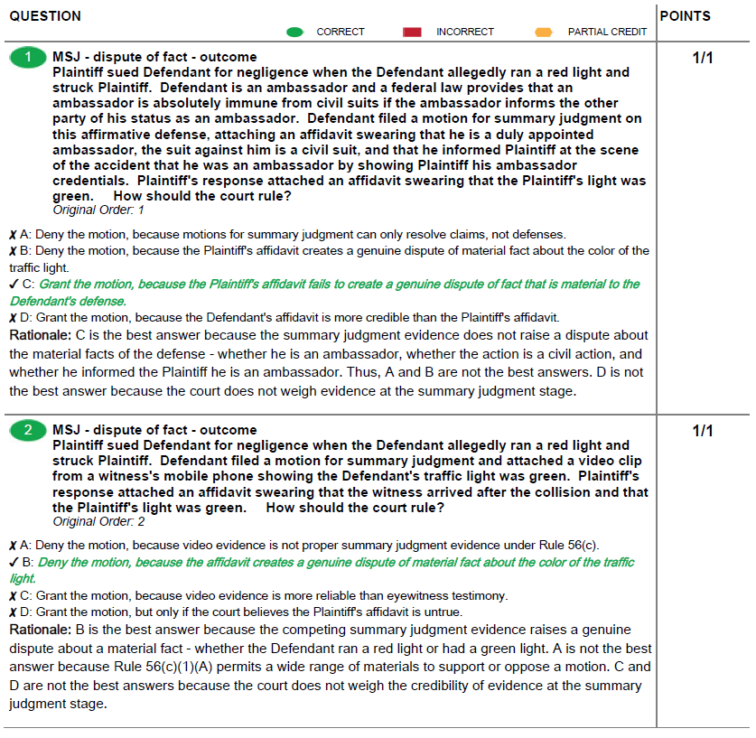

Slide 29
The Search for the Formative Assessment Program that Law Professors Will Love
Beth Donahue

Slide 30
High-Level Test Question Checklist
Every test question should:
test something important
in a straightforward manner
and at the appropriate time.

Slide 31
The Prompt-Learning Outcome Link
Facts or Reading:
Prompt:
Learning Outcome:
Which measure of damages is appropriate in this case?
Given a fact scenario involving a successful contract law cause of action, identify which measure of damages is appropriate under the studied case law.
Answer Options (if MCQ):

Slide 32
Have an Important Outcome in Mind
This must be important!
Prompt:
Learning Outcome:
Which measure of damages is appropriate in this case?
Given a fact scenario involving a successful contract law cause of action, identify which measure of damages is appropriate under the studied case law.
And hopefully, something you’re teaching your students to do—a task that they are not surprised to be tested on.

Slide 33
Link the Question to the Outcome
This must be linked to the outcome.
Prompt:
Learning Outcome:
Which measure of damages is appropriate in this case?
Given a fact scenario involving a successful contract law cause of action, identify which measure of damages is appropriate under the studied case law.

Slide 34
Program Crossroads: What is Important?
Score Comparability, Common Remediation
Academic Freedom, Flexibility
Course-Specific Learning Outcome
Given a fact scenario involving a successful contract law cause of action, identify which measure of damages is appropriate under the studied case law.
Prompt:
Which measure of damages is appropriate in this case?
Cross-Course Learning Outcome
Given a fact scenario involving a realistic legal action, use deductive reasoning and analogy to predict an outcome in the scenario based on the studied case law.

Slide 35
High-Level Test Question Checklist
Every test question should:
test something important
in a straightforward manner
and at the appropriate time.

Slide 36
Program Crossroads: What is Straightforward?
Score Comparability, Common Remediation
Drafter-Specific Editorial Guidelines
Academic Freedom, Flexibility
Course-Specific Learning Outcome
Common Editorial Guidelines
Prompt:
Which measure of damages is appropriate in this case?
Drafter-Specific Editorial Guidelines
Cross-Course Learning Outcome
Common Editorial Guidelines

Slide 37
High-Level Checklist
Every test question should:
test something important
☑ in a straightforward manner
and at the appropriate time.

Slide 38
Program Crossroads: When to Test?
Instructor-Controlled Test Building & Administration
Score Comparability, Common Remediation
Drafter-Specific Editorial Guidelines
Academic Freedom, Flexibility
Common Test Building & Administration
Course-Specific Learning Outcome
Common Editorial Guidelines
Instructor-Controlled Test Building & Administration
Prompt:
Common Test Building & Administration
Which measure of damages is appropriate in this case?
Drafter-Specific Editorial Guidelines
Instructor-Controlled Test Building & Administration
Cross-Course Learning Outcome
Common Test Building & Administration
Common Editorial Guidelines
Instructor-Controlled Test Building & Administration
Common Test Building & Administration

Slide 39
WARNING
Instructor-Controlled Test Building & Administration
Drafter-Specific Editorial Guidelines
Common Test Building & Administration
Course-Specific Learning Outcome
Common Editorial Guidelines
Instructor-Controlled Test Building & Administration
Prompt:
Common Test Building & Administration
Which measure of damages is appropriate in this case?
This path should not be used for formative purposes unless the curriculum is tightly controlled
Drafter-Specific Editorial Guidelines
Instructor-Controlled Test Building & Administration
Cross-Course Learning Outcome
Common Test Building & Administration
Common Editorial Guidelines
Instructor-Controlled Test Building & Administration
Common Test Building & Administration

Slide 40
BARBRI’s Product Offering (Under Development)
Instructor-Controlled Test Building & Administration
Drafter-Specific Editorial Guidelines
This path is designed to give schools the maximum cross-course comparability and longitudinal reporting capabilities—while maintaining the feedback loops necessary for increased learning.
Common Test Building & Administration
Course-Specific Learning Outcome
Common Editorial Guidelines
Instructor-Controlled Test Building & Administration
Prompt:
Common Test Building & Administration
Which measure of damages is appropriate in this case?
Drafter-Specific Editorial Guidelines
Instructor-Controlled Test Building & Administration
Generic Learning Outcome
Common Test Building & Administration
Common Editorial Guidelines
Instructor-Controlled Test Building & Administration
Common Test Building & Administration

Slide 41
?
beth.donahue@barbri.com

